Slide 1
Facade design pattern

Slide 2
Introduction
Facade design pattern is categorized under Structural design patterns.
it means the face of the building.

Slide 3
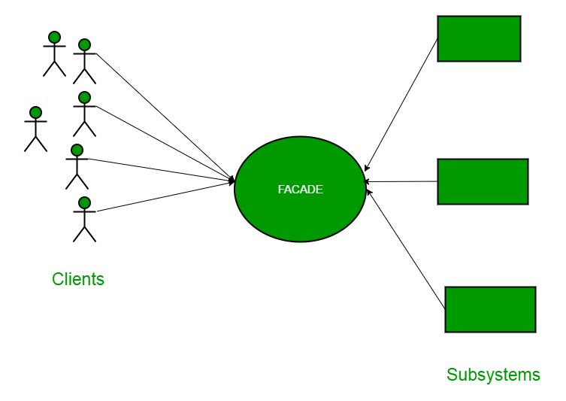
Problem definition
the startup of a computer. When a computer starts up, it involves the work of cpu, memory, hard drive, etc.
working with a large number of interdependent classes, or with classes that require the use of multiple methods, particularly when they are complicated to use or difficult to understand.

Slide 4
How it works ?
The Facade pattern basically says that you should simplify your methods so that much of what is done is in the background.
This pattern involves a single class which provides simplified methods required by client and delegates calls to methods of existing system classes.

Slide 5
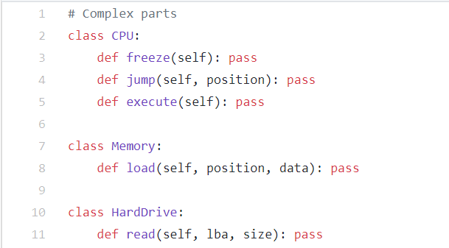
example

Slide 6
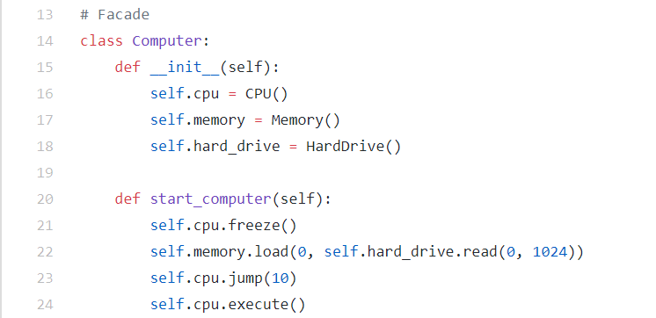
example

Slide 7
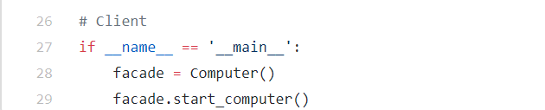
example

Slide 8
Draw backs
adds a layer of indirection which may affect performance.
does not add any functionality, it just simplifies interfaces.

